Slide 1
Chapter 6: Privacy and the Government

Slide 2
Chapter Overview
Introduction
Information collection by the government
Covert government surveillance
Regulation of public and private databases
Data mining by the government
National identification card
Information dissemination
Invasion

Slide 3
6.1 Introduction

Slide 4
A Balancing Act
Federal, state, and local governments in United States have had significant impact of privacy of individuals
Government must balance competing desires
desire to be left alone
desire for safety and security
National security concerns increased significantly after 9/11 attacks

Slide 5
Solove’s Taxonomy of Privacy
Information collection: Activities that gather personal information
Information processing: Activities that store, manipulate, and use personal information that has been collected
Information dissemination: Activities that spread personal information
Invasion: Activities that intrude upon a person’s daily life, interrupt someone’s solitude, or interfere with decision-making

Slide 6
6.2 Information Collection by the Government

Slide 7
Census Records
Census required to ensure every state has fair representation
Number of questions steadily rising
Sometimes Census Bureau has broken confidentiality requirement
World War I: draft resistors
World War II: Japanese-Americans

Slide 8
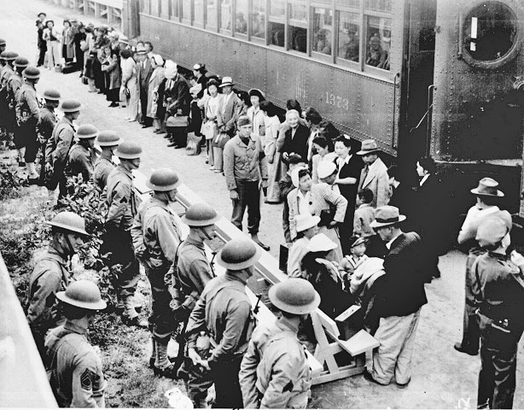
Japanese-Americans on Way to Internment Camp in 1942
National Archives, file #210-G-3B-414)
After the Japanese attack on Pearl Harbor, the Army used information illegally obtained from the Census Bureau to round up Japanese-Americans.

Slide 9
Internal Revenue Service Records
The 16th Amendment to the U.S. Constitution gives the federal government the power to collect an income tax
IRS collects more than $2 trillion a year in income taxes
Income tax forms contain a tremendous amount of personal information: income, assets, to whom you make charitable contributions, medical expenses, and more

Slide 10
FBI National Crime Information Center 2000
NCIC
Collection of databases related to various crimes
Contains > 39 million records
Successes
Helps police solve hundreds of thousands of cases every year
Helped FBI tie James Earl Ray to assassination of Dr. Martin Luther King, Jr.
Helped FBI apprehend Timothy McVeigh for bombing of federal building in Oklahoma City

Slide 11
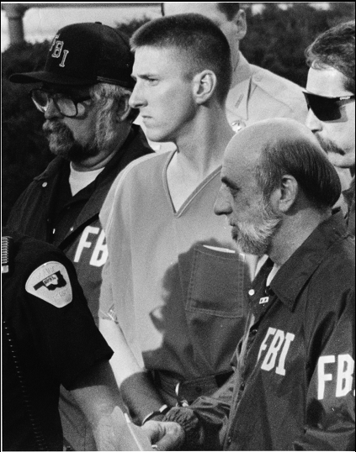
Timothy McVeigh
© Bob E.Daemmrich/Sygma/Corbis

Slide 12
OneDOJ Database
Database being constructed by U.S. Department of Justice
Gives state and local police officers access to information provided by five federal law enforcement agencies
Incident reports
Interrogation summaries
Other information not available through NCIC
Criticisms
OneDOJ gives local police access to information about people who have not been charged with a crime
There is no way to correct misinformation in raw police reports

Slide 13
Closed-circuit Television Cameras
First use in Olean, New York in 1968
Now more than 30 million cameras in U.S.
New York City’s effort in lower Manhattan
$201 million for 3,000 new cameras
License plate readers
Radiation detectors
Effectiveness of cameras debated

Slide 14
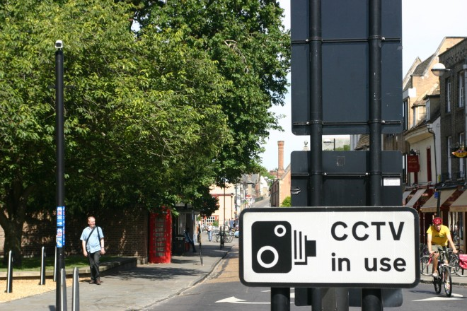
Number of Surveillance Cameras Keeps Increasing

Slide 15
6.3 Covert Government Surveillance

Slide 16
4th Amendment to U.S. Constitution
“The right of the people to be secure in their persons, houses, papers, and effects, against unreasonable searches and seizures, shall not be violated, and no Warrants shall issue, but upon probable cause, supported by Oath or affirmation, and particularly describing the place to be searched, and the persons or things to be seized.”

Slide 17
Wiretaps and Bugs
Omstead v. United States ⎯ wiretapping OK
Federal Communications Act ⎯ wiretapping made illegal
Nardone v. United States ⎯ wiretapping not OK
FBI continues secret wiretapping
Katz v. United States ⎯ bugs not OK

Slide 18
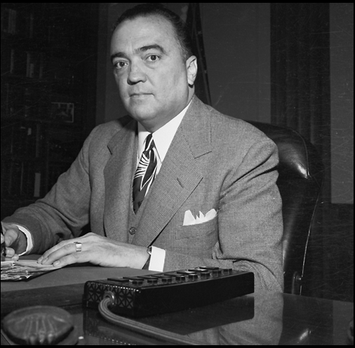
J. Edgar Hoover
© Bettmann/CORBIS

Slide 19
Operation Shamrock
Continuation of World War II interception of international telegrams
National Security Agency (1952)
Expanded to telephone calls
Kennedy
Organized crime figures
Cuba-related individuals and businesses
Johnson and Nixon
Vietnam war protesters
Nixon
War on drugs

Slide 20
Carnivore Surveillance System
Created by FBI in late 1990s
Monitored Internet traffic, including email exchanges
Carnivore = Windows PC + “packet-sniffing” software
Captured packets going to/from a particular IP address
Used about 25 times between 1998 and 2000
Replaced with commercial software

Slide 21
Covert Activities after 9/11
September 11, 2001 attacks on World Trade Center and Pentagon
President Bush authorized new, secret, intelligence-gathering operations inside United States

Slide 22
National Security Administration Wiretapping
President Bush signed presidential order
OK for NSA to intercept international phone calls & emails initiated by people inside U.S.
No search warrant required
Number of people monitored
About 500 people inside U.S.
Another 5,000-7,000 people outside U.S.
Two al-Qaeda plots foiled
Plot to take down Brooklyn bridge
Plot to bomb British pubs and train stations

Slide 23
TALON Database
TALON – Threat and Local Observation Notices
Created by U.S. Department of Defense in 2003
Supposed to contain reports of suspicious activities or terrorist threats near military bases
Reports submitted by military personnel or civilians
Reports assessed as “credible” or “not credible” by military experts
Reports about anti-war protests added to database
Many of these reports later deleted from database
In 2007 new Under Secretary of Defense for Intelligence recommended that TALON be terminated

Slide 24
6.4 Regulation of Public and Private Databases

Slide 25
Genesis of Code of Fair Information Practices
1965: Director of Budget asked committee of economists to look at problems caused by decentralization of statistical data across federal agencies
Committee recommended creation of a National Data Center
Citizens and legislators expressed concerns about possible abuses of such a system
Another group formed to draft guidelines for government databases

Slide 26
Code of Fair Information Practices
No secret databases
People should have access to personal information in databases
Organizations cannot change how information is used without consent
People should be able to correct or amend records
Database owners, users responsible for reliability of data and preventing misuse

Slide 27
Privacy Act of 1974 Falls Short
Applies only to government databases
Only covers records indexed by a personal ID
No federal employee responsible to enforcing Privacy Act provisions
Allows agencies to share records with other agencies

Slide 28
Legislation for Private Institutions
Fair Credit Reporting Act
Fair and Accurate Credit Transactions Act
Financial Services Modernization Act

Slide 29
Fair Credit Reporting Act
Passed in 1970, revised in 1996
Promotes accuracy and privacy of information used by credit bureaus
Major credit bureaus: Equifax, Experian, Trans Union
Negative information kept only 7 years
Exceptions
Bankruptcies: 10 years
Criminal convictions: indefinitely

Slide 30
Fair and Accurate Credit Transactions Act
Passed in 2004
Requires three major credit bureaus to provide consumers a free copy of their credit report every 12 months
Not automatic: consumers must request credit reports
Provisions to reduce identity theft

Slide 31
Financial Services Modernization Act
Also called Gramm-Leach-Bliley Act of 1999
Creates “financial supermarkets” offering banking, insurance, and brokerage services
Privacy-related provisions
Privacy policies must be disclosed to customers
Notices must provide an opt-out clause
Companies must develop procedures to protect customers’ confidential information

Slide 32
6.5 Data Mining by the Government

Slide 33
Definition of Data Mining
Data mining: Process of searching through one or more databases looking for patterns or relationships among the data

Slide 34
IRS Audits
IRS uses computer matching and data mining to look for possible income tax fraud
Computer matching: matching tax form information with information provided by employers, banks, etc.
Data mining: searching through forms to detect those that appear most likely to have errors resulting in underpayment of taxes

Slide 35
Syndromic Surveillance Systems
Syndromic surveillance system: A data mining system that searches for patterns indicating the outbreak of an epidemic or bioterrorism
911 calls
emergency room visits
school absenteeism
Internet searches
Example: A system in New York City detected an outbreak of a virus in 2002

Slide 36
Telecommunications Records Database
Created by National Security Agency after 9/11
Contains phone call records of tens of millions of Americans
NSA analyzing calling patterns to detect terrorist networks
Phone records voluntarily provided by several major telecommunications companies
USA Today revealed existence of database in May 2006
Several dozen class-action lawsuits filed
August 2006: Federal judge in Detroit ruled program illegal and unconstitutional
July 2007: U.S. Court of Appeals overturned ruling, saying plaintiffs did not have standing to bring suit forward

Slide 37
6.6 National Identification Card

Slide 38
History, Role of Social Security Number
Social Security cards first issued 1936
Originally used only for SS purposes
Use of SSN has gradually increased
SSN is a poor identification number
Not unique
Rarely checked
No error-detecting capability

Slide 39
Arguments for a National ID Card
Current ID cards are second-rate
Would reduce illegal entry to U.S.
Would prevent illegal aliens from working
Would reduce crime
Other democratic countries have national ID cards

Slide 40
Arguments against a National ID Card
No card positively guarantees identification
No biometric-based system is 100% accurate
No evidence it will reduce crime
Makes government data mining simpler
Make law-abiding people more vulnerable to fraud and indiscretions

Slide 41
The REAL ID Act
Signed in May 2005
Significantly changes driver’s licenses in the United States
New licenses
Issued by end of 2013
Required to open bank account, fly on commercial airplane, or receive government service
Requires applicants to supply 4 different IDs
Will probably contain a biometric identifier
Must contain data in machine-readable form
Half of the states have resisted implementation of REAL ID; doubtful 2013 deadline will be met

Slide 42
Possible Consequences of New Licenses
Better identification means better law enforcement
People won’t be able to change identities
Parents ducking child support
Criminals on the run
New, centralized databases could lead to more identity theft

Slide 43
6.7 Information Dissemination

Slide 44
Legislation to restrict information dissemination
Family Education Rights and Privacy Act
Video Privacy Protection Act
Health Insurance Portability and Accountability Act
Examples of information dissemination
Freedom of Information Act
Toll booth records used in court

Slide 45
Family Education Rights and Privacy Act (FERPA)
Rights given to
Students 18 years and older
Parents of younger students
Rights include
Reviewing educational records
Requesting changes to erroneous records
Preventing release of records without permission

Slide 46
Video Privacy Protection Act
Videotape service providers cannot disclose rental records without consumer’s written consent
Rental stores must destroy personal information related to rentals within a year of when it is no longer needed

Slide 47
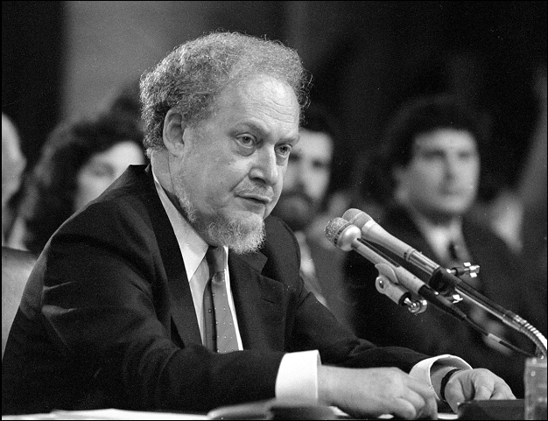
Judge Robert Bork
AP Photo/Charles Tasnadi

Slide 48
Health Insurance Portability and Accountability Act
Limits how doctors, hospitals, pharmacies, and insurance companies can use medical information
Health care providers need signed authorization to release information
Health care providers must provide patients with notice describing how they use medical information

Slide 49
Freedom of Information Act
Federal law designed to ensure public has access to U.S. government records
Signed by President Johnson (1966)
Applies only to executive branch
Nine exemptions
Classified documents
Trade secrets or financial information
Documents related to law enforcement investigations

Slide 50
Toll Booth Records
E-ZPass: an automatic toll-collection system used on most toll roads, bridges, and tunnels between Illinois and Maine
Drivers with E-ZPass tags pass through without stopping to pay attendant
Records have been provided in response to court orders in criminal and civil cases

Slide 51
6.8 Invasion

Slide 52
Government actions to prevent invasion
Do Not Call Registry
CALM Act
Invasive government actions
Requiring identification for pseudoephedrine purchases
Advanced Imaging Technology scanners at airports

Slide 53
National Do Not Call Registry
FTC (Federal Trade Commission) responded to public opinion
Created Do Not Call Registry in 2003
More than 50 million phone numbers registered before it even took affect
Example of how privacy is treated as a prudential right
Benefit of shielding people from telemarketers judged to be greater than harm caused by limiting telephone advertising

Slide 54
CALM Act
Television watchers have complained to FCC (Federal Communications Commission) about loud commercials since 1960s
CALM (Commercial Advertisement Loudness Mitigation) Act signed by President Obama in 2010
Requires FCC to ensure television commercials are played at same volume as programs they are interrupting

Slide 55
Pseudoephedrine Purchases
Pseudoephedrine an ingredient of Sudafed and other cold medications
It is also an ingredient of methamphetamine (“meth”)
Federal and state governments have passed laws limiting access to pseudoephedrine
Limits quantity that can be purchased in a month
Identification and signature required for purchase in most states

Slide 56
Advanced Imaging Technology Scanners
Transportation Security Administration began installing AIT scanners in 2007
AIT scanners reveal anatomical features
Electronic Privacy Information Center sued government in 2010, saying systems violate 4th Amendment and various laws
February 2011: TSA announced it was developing new software that would replace detailed image with generic outline of a person

Slide 57
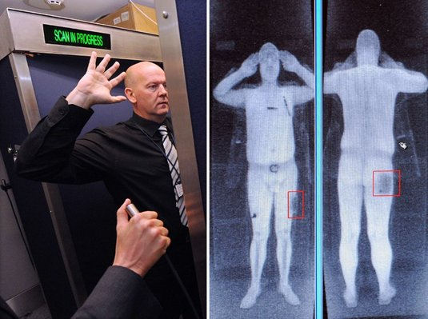
Advanced Imaging Technology Scanner

